Slide 1
Chapter 9
An Introduction to
Analysis of Variance
Terry Dielman
Applied Regression Analysis:
A Second Course in Business and Economic Statistics, fourth edition

Slide 2
ANOVA
Analysis of variance was a term used in regression to describe how we split the variation in our sample into "explained" and "unexplained" parts.
In this chapter we will look at some other ANOVA procedures where the model doing the "explaining" is different.

Slide 3
9.1 One-Way Analysis of Variance
Consider a problem that has K populations. We can write:
y_{ij} = µ_{i} + e_{ij}
The notation:
y_{ij} is the j^{th} observation in population i
µ_{i} is the mean for population i
e_{ij} is a random disturbance
The population index i ranges from 1 to K and the observation index j from 1 to n_{i}.

Slide 4
Sample Sizes
The use of the subscript on n implies that the sample sizes can differ although it is often better if they are about equal in size.
Our combined (overall) sample size will be denoted without a subscript as just n.
It is the sum of the K individual n_{i}.

Slide 5
Assumptions About Disturbances
We make the same assumptions as in regression analysis:
  The e_{ij} have mean 0.
  The e_{ij} have constant variance σ²_{e}.
  The e_{ij} are normally distributed.

Slide 6
ANOVA Terminology
ANOVA has its own terminology. The dependent variable y is said to differ due to factors (here, different populations).
A level of a factor is a particular population.
In one-way ANOVA we often refer to the factor levels as treatments.

Slide 7
Alternative Representation
We can rewrite the model to show the treatment effects γ_{i}.
Suppose we let the overall mean be denoted µ. The alternate form is:
y_{ij} = µ + γ_{i} + e_{ij}
A factor-level mean is µ_{i} = µ + γ_{i}

Slide 8
Hypothesis Test
The question we want to answer is "are all the population means equal?"
The hypotheses for this are:
H₀: µ₁ = µ₂ = ... = µ_{K}
H_{a}: At least one µ_{i} is different
An equivalent would be to claim all the treatment effects are the same.

Slide 9
The F Test
As in regression, we perform the test by partitioning the variation in the sample.
We have unexplained variation (SSE) and explained variation (SSTR) which is a function of the difference in treatment means.
After dividing by appropriate degrees of freedom, the F is a ratio of mean squares:
F = MSTR/MSE

Slide 10
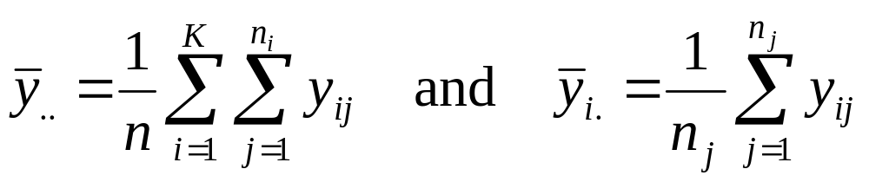
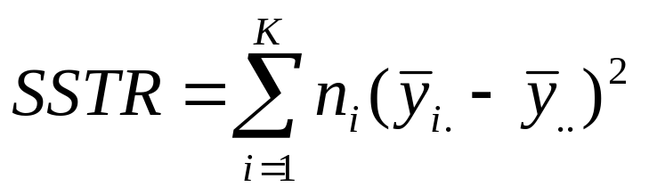
Computing SSTR
Compute an overall mean and a mean for each sample:
Next compute the treatment sum of squares:

Slide 11
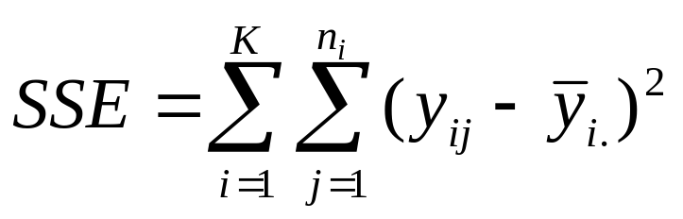
Computing SSE
As in regression we compute fit errors, but now we use the treatment means as predictors:
The error sum of squares is thus:
SSTR has (K-1) degrees of freedom and SSE has (n-K).

Slide 12
Example 9.1 Automobile Injuries
The file INJURY9 contains data on injury claims involving 112 models of 1984-86 cars.
The variable INJURIES is the number of claims for each model and the variable CARCLAS indicates which category (small 2-door, small 4-door, etc.) the car falls into.

Slide 13
Minitab Output
Analysis of Variance for INJURIES
Source DF SS MS F P
CARCLAS 8 54762 6845 22.80 0.000
Error 103 30917 300
Total 111 85679
Individual 95% CIs For Mean
Based on Pooled StDev
Level N Mean StDev -+---------+---------+---------+-----
1 20 127.10 21.89 (--*--)
2 13 105.00 16.29 (---*---)
3 4 68.25 9.07 (------*------)
4 18 124.22 25.58 (---*--)
5 23 94.57 13.38 (--*--)
6 6 66.33 3.72 (-----*----)
7 7 88.29 9.64 (----*-----)
8 13 82.62 14.21 (---*---)
9 8 60.00 6.23 (----*----)
-+---------+---------+---------+-----
Pooled StDev = 17.33 50 75 100 125

Slide 14
The F Test
The F ratio has 8 numerator and 103 denominator degrees of freedom.
At a 5% significance level, the critical value is 2.10
From the output SS(CARCLASS) is 54762 so MSTR is 54762/8 = 6845.
MSE = 300 and F=6845/300 = 22.8
We reject the hypothesis that all types of cars have the same number of accidents.

Slide 15
Which are higher or lower?
The Minitab output below the ANOVA table presents some information that helps us figure that out.
The intervals for µ₁ and µ₄ are distinctly higher than the other types and there is a lot of overlap among the others.
At minimum, we can say that category 1 (small 2-door) and category 4 (small 4-door) had significantly more injury claims.
We will look at more precise ways to do comparisons in the next example.

Slide 16
Comments on the Comparisons
The data represents number of injury claims, not a rate, so it is possible that these two are high just because more small cars are out there.
It is also possible that these small cars provide less protection, so more injuries occur during accidents.

Slide 17
Planned Experiments
ANOVA is often used to analyze data collected during a designed experiment.
The term design refers to the plan for conducting the experiment.
The researcher can assign the objects in the experiment to specific treatments, often to achieve a balanced experiment with equal n_{i}.
We had no control like this in the injury analysis.

Slide 18
Example 9.2 Computer Sales
We are studying three different approaches for selling computers.
Fifteen different salespeople are randomly assigned to the sales methods, five to each approach.
At the end of a month, we collected sales figures from each.

Slide 19
Minitab Output
Analysis of Variance for Sales
Source DF SS MS F P
Approach 2 384.5 192.3 8.47 0.005
Error 12 272.4 22.7
Total 14 656.9
Individual 95% CIs For Mean
Based on Pooled StDev
Level N Mean StDev --+---------+---------+---------+----
1 5 15.600 3.578 (-------*-------)
2 5 21.600 5.727 (-------*-------)
3 5 28.000 4.743 (-------*------)
--+---------+---------+---------+----
Pooled StDev = 4.764 12.0 18.0 24.0 30.0
Approaches are significantly different

Slide 20
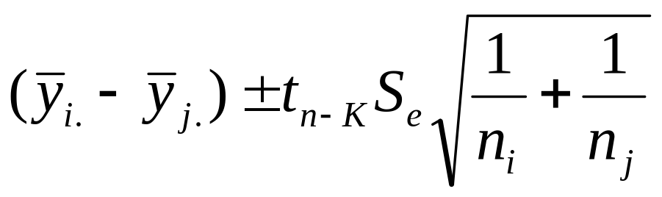
Pairwise Comparisons
A better way to compare any two means for differences is a variation of our two-sample interval from Chapter 2.
For comparing approach i to approach j, compute the interval:
S_{e} is the pooled 3-sample standard deviation, the square root of MSE.

Slide 21
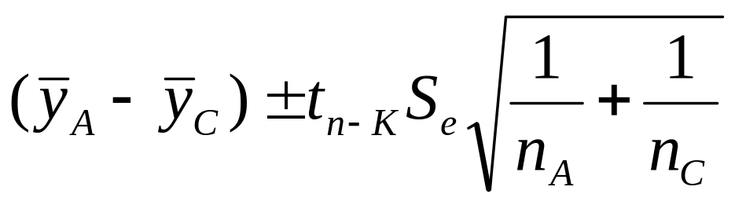
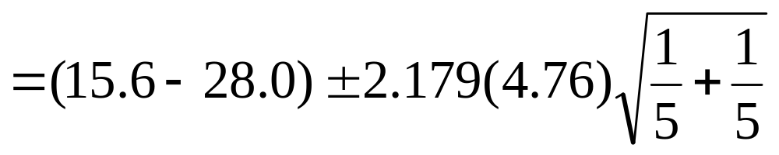
Comparing A to C
For A to C:
or (-18.96, -5.84).
We can claim the people using approach C sell from $5,840 to $18,960 more than those using approach A.

Slide 22
Multiple Comparisons
The confidence level for this single comparison is 95%, but if you did many such comparisons, "overall" confidence will be lower.
If we compared each approach to the others, that would be three 95% intervals.
The overall confidence is roughly 85%.

Slide 23
Bonferroni Method
The Bonferroni approach is a method for performing comparisons that are planned in advance.
It essentially controls overall confidence by using a larger t multiplier.
If there are g 95% comparisons planned, find the t value that has tail probability of (.025/g).

Slide 24
All Three Comparisons
If ahead of time we knew we wanted to compare each sales method to the other two, we have g=3.
Find the t value with (.025/3) = .008 tail probability.
Using Excel's or Minitab's probability function, you can find that t=2.802
If you had no other way to find out what this is, to be safe use the tabled value at .005, which is 3.055.

Slide 25
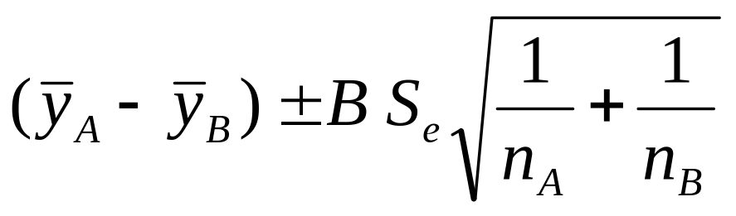
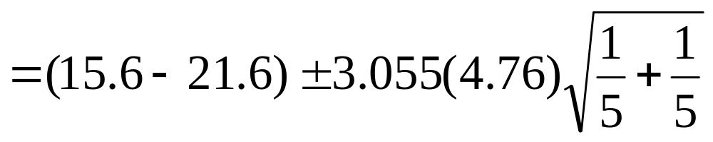
Comparing All 3
The first interval is:
or (-15.20, 3.20) no difference
A to C is: (-21.60, -3.20) C is better
B to C is: (-15.60, 2.80) no difference

Slide 26
The Tukey Procedure
The Bonferroni approach can be used for more than pairwise comparisons.
For example, we could compare method A to the average of methods B and C.
If you only plan on the pairwise comparisons, the Tukey procedure is more efficient.

Slide 27
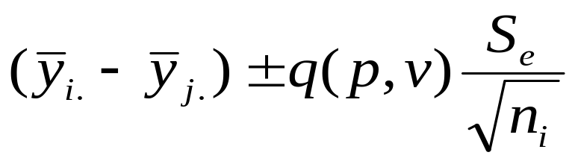
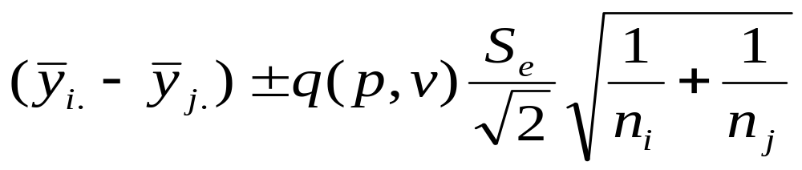
Tukey Intervals
When sample sizes are equal:
If they differ:
q is the critical value of the Studentized range (Appendix B), p is the number of treatments and v=n-K is the error df.

Slide 28
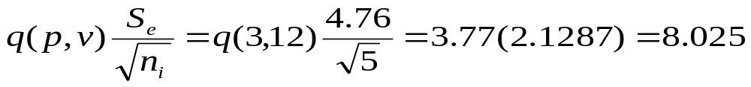
Tukey Calculations
Since we have equal sample sizes, we use the first formula. The ± amount will be the same for all:
A to B: (15.6-21.6) ± 8.025 = (-14.03, 2.03)
A to C: (15.6-28.0) ± 8.025 = (-20.43,-4.37)
B to C: (21.6-28.0) ± 8.025 = (-14.43, 1.63)
We still have the same results but got a little closer to a significant difference on the A to B and B to C comparisons.

Slide 29
Minitab Output With Tukey Option
Tukey 95% Simultaneous Confidence Intervals
All Pairwise Comparisons among Levels of APPROACH
Individual confidence level = 97.94%
APPROACH = 1 subtracted from:
APPROACH Lower Center Upper ----+---------+---------+---------+-----
2 -2.033 6.000 14.033 (-------*-------)
3 4.367 12.400 20.433 (-------*-------)
----+---------+---------+---------+-----
-10 0 10 20
APPROACH = 2 subtracted from:
APPROACH Lower Center Upper ----+---------+---------+---------+-----
3 -1.633 6.400 14.433 (-------*-------)
----+---------+---------+---------+-----
-10 0 10 20

Slide 30
9.2 ANOVA Using A Randomized Block Design
Consider again the computer sales problem; one thing affecting the results is that some people are better salespersons regardless of what approach they are using.
If we had a way of including that information, we could "block out" the talent effect and get a better idea about which sales method is better.
This is what a randomized block design does.

Slide 31
Repeated Measures Designs
One way to incorporate talent is to just use 5 salespersons and have each use a different method each month.
To minimize any effects of time order, we would randomly assign the order in which they use the approaches.
When we are all done we can compute each person's average sales to measure relative talent.

Slide 32
Example 9.6 Cereal Package Design
We have four different designs of cereal packages and want to determine which one sells better.
We have 20 stores to use in the study.
A potential confounding factor is that more sales will occur in larger stores.
We can block this out by dividing the stores up into five size groups of four stores each. Each package design will be used in one store in each group.

Slide 33
The Randomized Block Model
Our model is:
y_{ij} = µ + γ_{i} + B_{j} + e_{ij}
y_{ij} is the single observation for treatment i in block j
µ is the overall mean
γ_{i} is the effect of the i^{th} treatment
B_{j} is the effect of the j^{th} block
e_{ij} is a random disturbance

Slide 34
One Observation per Cell
We assume here that there is only a single observation per combination of block and treatment.
Repeats can be handled but we would have to make some adjustments to some formula and add another subscript.
Leave those to the computer.

Slide 35
F Tests
Another row gets added to the ANOVA table.
Our sources of variation are now error, blocks and treatments.
We can perform an F test for block effects.
Our main interest is the test for the treatment effects.

Slide 36
F Ratios
For block test, F = MSBL/MSE
There are b block levels so the numerator has (b-1) degrees of freedom.
For treatments, use F = MSTR/MSE
The numerator has (K-1) d.f.
MSE has (b-1)(K-1) d.f.

Slide 37
Output for Cereal Package Design Analysis
Analysis of Variance for SALES
Source DF SS MS F P
SIZE 4 1521.7 380.4 4.17 0.024
DESIGN 3 31.0 10.3 0.11 0.951
Error 12 1093.5 91.1
Total 19 2646.2
Individual 95% CI
SIZE Mean ------+---------+---------+---------+-----
1 28.3 (--------*-------)
2 35.5 (--------*-------)
3 39.8 (--------*--------)
4 46.5 (--------*-------)
5 53.5 (--------*-------)
------+---------+---------+---------+-----
24.0 36.0 48.0 60.0
Individual 95% CI
DESIGN Mean ----------+---------+---------+---------+-
1 40.4 (--------------*---------------)
2 40.0 (---------------*--------------)
3 39.6 (---------------*---------------)
4 42.8 (--------------*---------------)
----------+---------+---------+---------+-
36.0 42.0 48.0 54.0

Slide 38
Analyzing the Results
First, the F test for the store size effect is significant (F=4.17 has a p-value of 0.024). The means plot below the ANOVA table shows that sales do increase with size.
The F test for package design is not significant (F=0.11 has p =.951). Thus, it does not appear that any one design works better than others.

Slide 39
9.3 Two-Way ANOVA
In this situation, there are two factors or explanatory variables.
For example, suppose a company is going to experiment with two price levels and three types of advertising.
Now a "treatment" is considered a price-advertising combination, of which there are 6.

Slide 40
Factorial Designs
This type of problem is called a factorial design.
When all possible combinations of the two factors are used, it is a complete factorial experiment.
We will assume that all treatments have the same number of observations; although it is possible to do factorial designs without equal samples.

Slide 41
The Two-Way ANOVA Model
Our model is:
y_{ijk} = µ +α_{i} + β_{j} + (αβ)_{ij} + e_{ijk}
y_{ijk} is the k^{th} observation at factor level i for
factor A and factor level j for factor B
µ is the overall mean
α_{i} is the effect of factor A at level i
β_{j} is the effect of factor B at level j
(αβ)_{ij} is the interaction between factors
e_{ijk} is a random disturbance

Slide 42
Hypothesis Tests
The tests for the effects of factor A and factor B are called tests for the main effects and these are what we are mainly interested in.
You should first test for interaction. Interaction means that the effect of factor A may depend on the level of factor B.
If there is no interaction, the main effects are independent of each other.

Slide 43
Degrees Of Freedom
Assume that factor A has n₁ levels and factor B has n₂ levels, and that we have r observations for each treatment.
The four sources of variation and thier associated degrees of freedom:
factor A (n₁-1)
factor B (n₂-1)
interaction (n₁-1)(n₂-1)
error (rn₁n₂ – 1)

Slide 44
Means Plot
A good exploratory tool is to plot the average value of y that occurs at each treatment.
The average y goes on the vertical axis and one of the factors on the horizontal axis.
Use lines to connect the means for the other factor.
If the lines are roughly parallel, it is a signal that there is no interaction.

Slide 45
Example 9.8 Printer Sales
The company is experimenting with the price of its top-of-the-line printer and how it is advertised.
They set the price at either $600 (1) or $700 (2) and the advertising was either by television (1), radio (2) or newspaper (3).
They record the sales for one month, and each combination was run twice, so we have 12 observations.

Slide 46
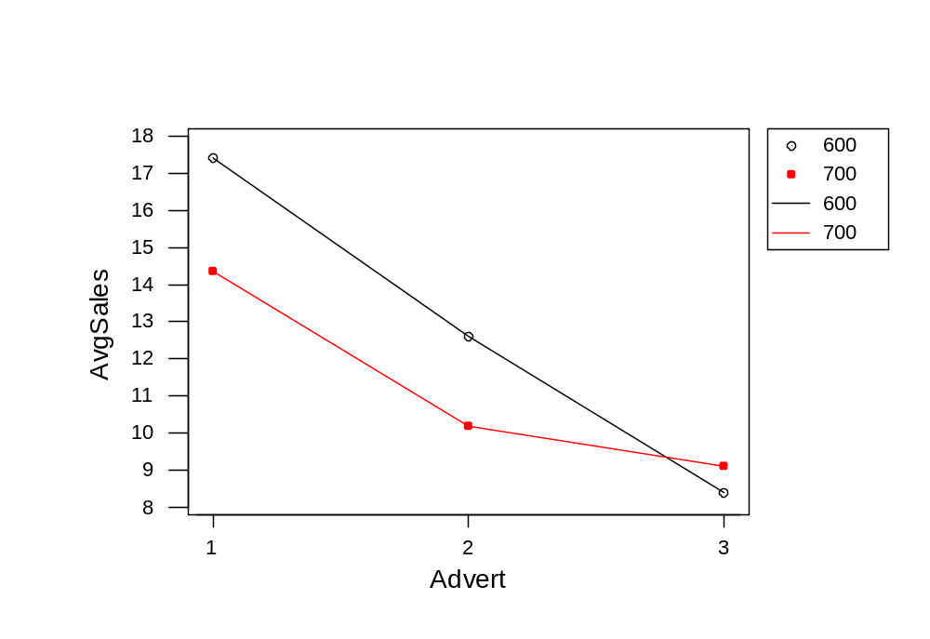
Means Plot

Slide 47
Tentative Findings
In general, sales were higher at the lower price.
They were highest for TV advertising and next for radio.
A mild potential interaction is present because the higher price did better when using newspaper advertising.

Slide 48
ANOVA Output
Two-way ANOVA: SALES versus ADV, PRICE
Analysis of Variance for SALES
Source DF SS MS F P
ADV 2 103.752 51.876 75.82 0.000
PRICE 1 7.521 7.521 10.99 0.016
Interaction 2 8.032 4.016 5.87 0.039
Error 6 4.105 0.684
Total 11 123.409

Slide 49
Test for Interaction
The test for interaction is significant. The F ratio is 5.87 compared to a critical value from F_{2,6} = 5.14. The p-value is .039.
If strong interaction is present, it means it may be hard to sort out the main effects (and you may not even want to test for them).
The interaction is not real strong so we will test for main effects.

Slide 50
Main Effects
Test for Selling Price
The test is significant (F=10.99 has p=.016) so selling price does matter.
Test for Advertising Effect
This is even more significant (F=75.82 has p=.000).

Slide 51
The Optimal Policy
Sales are certainly highest when the price is set at $600 and television advertising is used.
These are not surprising results and they also represent the most costly combination.
If we had profit—instead of revenue—information, we may have a different opinion on what to do.

Slide 52
9.4 Analysis of Covariance
A close relative to ANOVA is ANCOVA where the model contains a mixture of quantitative and qualitative predictors.
These are often analyzed by a General Linear Model procedure.
In these procedures you specify the y variable and its predictors. You then indicate which are factors (qualitative) and which are covariates (quantitative).
In essence, it is just regression analysis with both continuous and indicator variables.
Using a GLM procedure often makes it easier to specify the model form, particularly when interaction is involved.

